Slide 1


RealTime Messenger
A MINOR PROJECT-II
Submitted in Partial Fulfillment of the Requirement for the Award of the Degree of
BACHELOR OF TECHNOLOGY
IN
COMPUTER SCIENCE & ENGINEERING-DATA SCIENCE
SUBMITTED TO
Rajiv Gandhi Proudyogiki Vishwavidyalaya, Bhopal (M.P.)
SUBMITTED BY
ANUJ RAJ (0176CD211026)
ATHARV JAIN (0176CD211031)
VIVEK KUMAR (0176CD211136)
UNDER THE SUPERVISION OF
Dr Saket Jain
Department of Computer Science & Engineering
Department of Computer Science & Engineering-Data Science
Lakshmi Narain College of Technology Excellence, Bhopal (M.P.)
June 2024

Slide 2
RealTime Messenger
-By Anuj Raj II Atharv Jain II Vivek Kumar

Slide 3
Agenda
INTRO
SYSTEM OVERVIEW
SYSTEM BENEFITS
LANGUAGE USED
SIGN UP PAGE
SIGN IN PAGE
CONVERSATION PAGE
DIAGRAM FRAMEWORK
CONCLUSION
FUTURE SCOPES

Slide 4
Intro
Realtime Messenger: Building Connections, Instantly
Welcome to the Realtime Messenger project presentation
In today's fast-paced world, communication is key. Realtime Messenger is your solution for instant messaging, connecting you with friends, family, and colleagues in real-time.

Slide 5
System Overview
Sign-up Page:
The Sign-up page allows new users to create an account on the Realtime Messenger platform.
Sign-in Page:
The Sign-in page allows registered users to access their accounts on the Realtime Messenger platform.
Users are prompted to enter their login credentials, including email address and password.
Message Page:
The Message page serves as the central hub for user communication within the Realtime Messenger platform.

Slide 6
System Benefits
Instant Communication: Realtime Messenger enables users to communicate instantly with friends, family, and colleagues, fostering quick and efficient exchange of messages.
Enhanced Collaboration: The platform facilitates seamless collaboration among users, allowing teams to work together in real-time, share updates, and coordinate tasks effectively.
User-Friendly Interface: With an intuitive user interface, Realtime Messenger offers a simple and easy-to-navigate platform, ensuring a positive user experience for all.
Scalability: The system is designed to scale with the growing needs of users and organizations, accommodating increasing user base and message traffic without compromising performance.
Data Security: Realtime Messenger prioritizes the security and privacy of user data, employing robust encryption techniques and stringent access controls to safeguard sensitive information.
Cross-Platform Compatibility: The messaging platform is accessible across various devices and platforms, including desktops, laptops, smartphones, and tablets, ensuring flexibility and convenience for users.

Slide 7




Language Used
PYTHON
flet
WEB SOCKET
SQLITE3

Slide 8
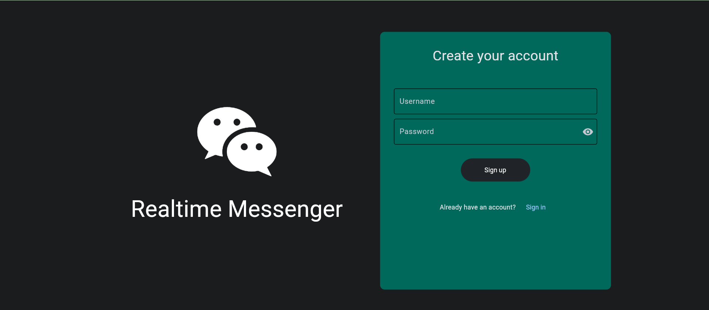
Sign Up Page

Slide 9
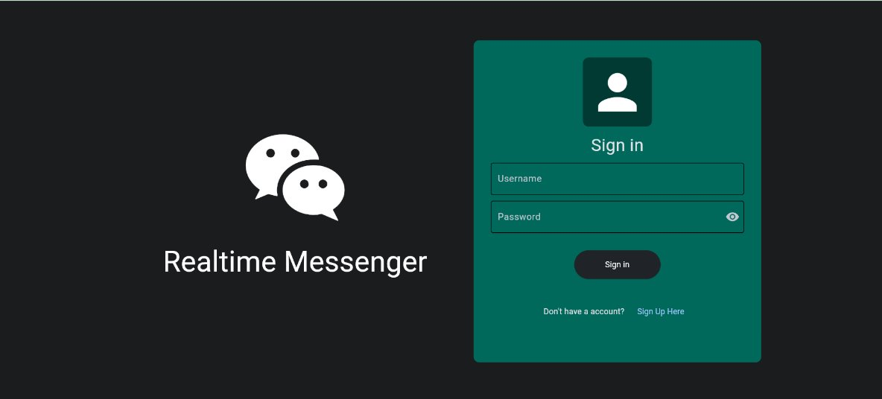
Sign In Page

Slide 10
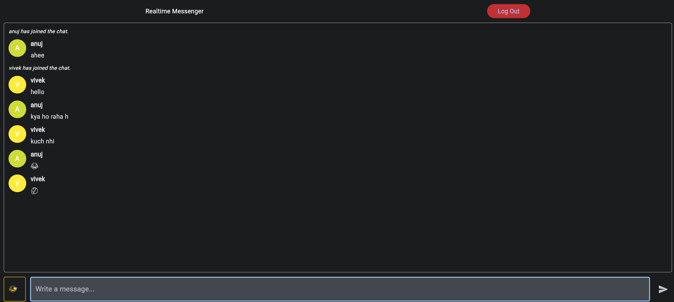
Conversion Page

Slide 11
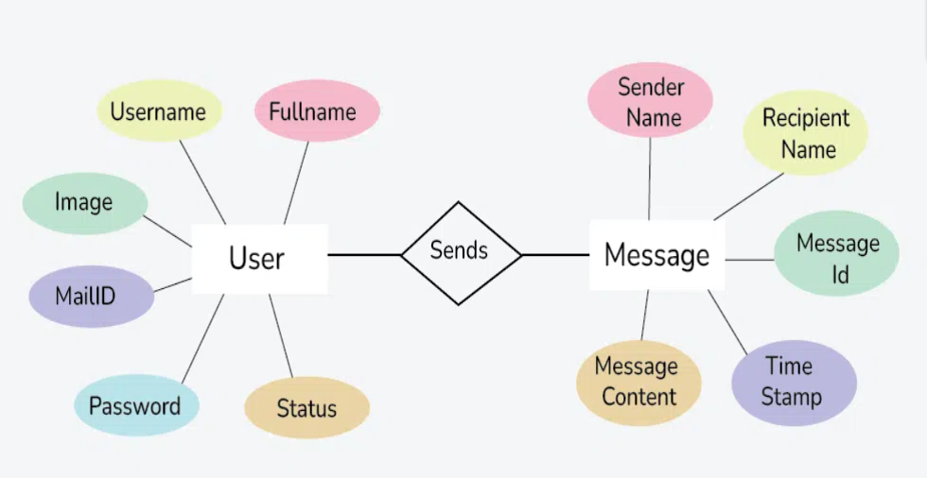
Diagram Framework
E
R
D
I
A
G
R
A
M

Slide 12
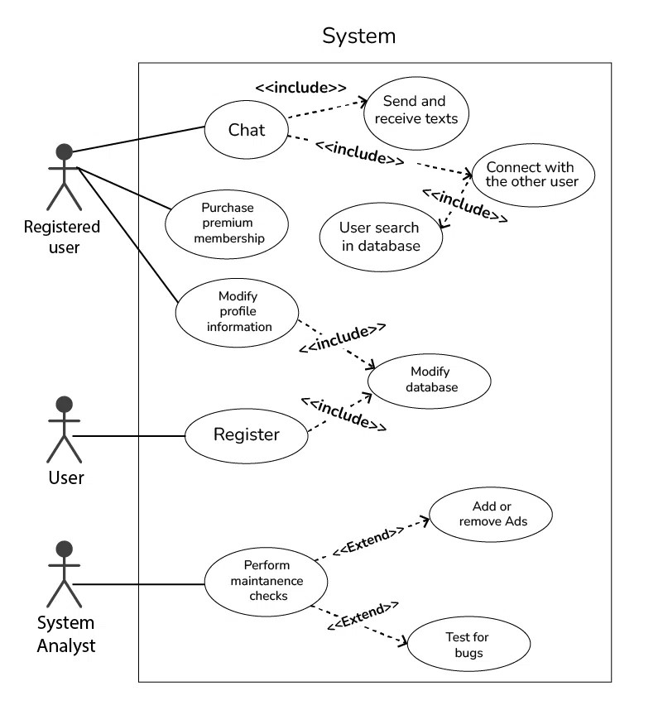
Diagram Framework
U
S
E
C
A
S
E

Slide 13
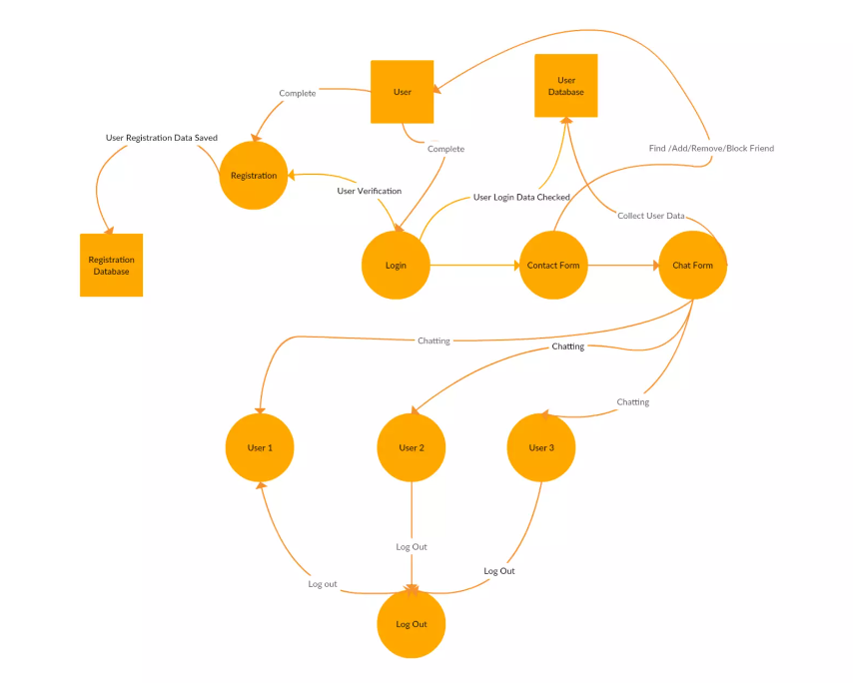
Diagram Framework
D
F
D
D
I
A
G
R
A
M

Slide 14
Conclusion
In conclusion, Realtime Messenger represents a significant advancement in the realm of instant messaging platforms. With its user-friendly interface, robust security features, and seamless communication capabilities, Realtime Messenger offers a reliable solution for users to connect and collaborate in real-time.
As we've explored throughout this presentation, Realtime Messenger is designed to meet the diverse needs of modern users, providing instant communication, enhanced collaboration, and a positive user experience.
With its scalability, cross-platform compatibility, and customization options, Realtime Messenger is well-positioned to adapt to the evolving needs of users and organizations, ensuring continued success and relevance in the dynamic digital landscape.

Slide 15
Future Scopes
Integration of Artificial Intelligence:
Enhanced Security Measures
Multimedia Messaging
Cross-Platform Compatibility

Slide 16
Our Team
ANUJ RAJ
Project Creator
ATHARV ARYAN
Representator
VIVEK KUMAR
Report Handler

Slide 17
Thank you

